Slide 1


Hoạch định nguồn lực doanh nghiệp ERP
Trình bày: GV Đỗ Duy Thanh

Slide 2
Nội dung của phần quy trình trong ERP
Dự báo & lập kế hoạch sơ bộ
Bán hàng & phân phối
Sản xuất
Vật tư & Kho bãi
Kế toán trong Logistics

Slide 3
Part 5 Basic of Accounting

Slide 4
Agenda
Khái niệm về FI
FI Master Data
FI in Logistics
Questions?
Reports

Slide 5
Question???
Bạn bán được bao nhiêu tiền? Bao nhiêu tiền mặt, bao nhiêu tiền trong ngân hàng?
Khách hàng nợ bao nhiêu? Phải trả cho nhà cung cấp là bao nhiêu?
Tổng giá trị hàng tồn kho là bao nhiêu?
Tổng giá trị tài sản của công ty là bao nhiêu?
Tại sao doanh thu có nhưng tiền mặt không thấy đâu?
Sau bao nhiêu năm làm ăn, thì nhìn lại mình kinh doanh hiệu quả không?

Slide 6
Key concept Financial Accounting (FI)
Khái niệm về FI
FI Master Data
FI in Logistics
Questions?
Reports
Financial Accounting is designed to collect the transactional data (giao dịch)that provides a foundation for preparing the standard portfolio of reports(báo cáo tài chính).
In general, these reports are primarily, but not exclusively, directed at external parties.
Standard reports include:
Balance Sheet – Bảng cân đối kế toán
Income Statement – Báo cáo Doanh thu
Statement of Cash Flows – Báo cáo dòng tiền (openerp missing)

Slide 7
Key concept (cont.) Target Audience (Users)
Khái niệm về FI
FI Master Data
FI in Logistics
Questions?
Reports
Internal
Executives
Senior Management
Administrative Staff
Employees
External
Legal Authorities
Banks
Auditors
Shareholders
Insurance
Taxing Authorities
Media
Financial Analysts

Slide 8

Key concept (cont.)
Khái niệm về FI
FI Master Data
FI in Logistics
Questions?
Reports
FI liên quan đến việc tính toán xem công ty mua, bán, sở hữu, hay nợ ra sao.
FI là lõi, là xương sống gắn kết tất cả các Module khác lại với nhau.
Gắn kết ra sao?? SD, PP, MM
Ex: Sales recorded in SD affect revenue and customer accounts in FI
FI truyền thống xử dụng phương thức kế toán kép với tài khoản chữ T
“Kế toán kép” vì mỗi giao dịch phát sinh đều ảnh hưởng đến 2 loại tài khoản
Debit
(Nợ)
Credit
(Có)
Balance
Balance

Slide 9
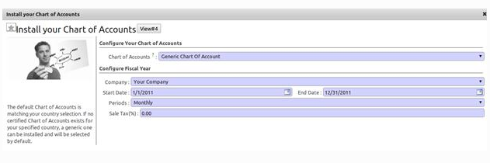
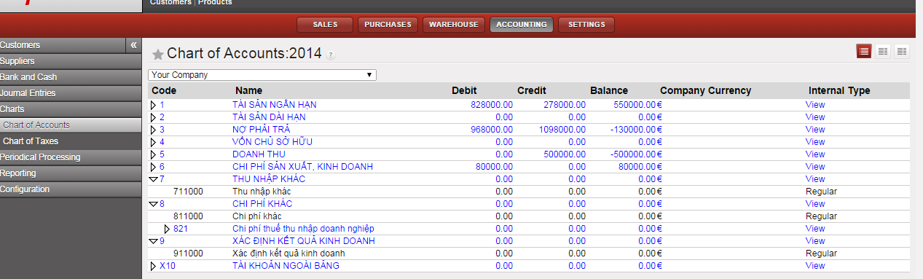
Master Data – Chart of Acc
Khái niệm về FI
FI Master Data
FI in Logistics
Questions?
Reports
Chart of Accounts: danh mục tài khoản (mỗi quốc gia có thể khác nhau)
111, 632, 156, 331….
Ở Việt Nam có 9 loại tài khoản

Slide 10
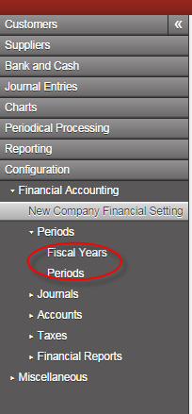
Financial Year & Period
Khái niệm về FI
FI Master Data
FI in Logistics
Questions?
Reports
Năm tài chính: khoản thời gian 12 tháng kể từ ngày bắt đầu (đăng ký với cơ quan thuế)
Kỳ tài chính: tháng hay quý. Cần để mở và kết thúc giao dịch tài chính. Phục vụ báo cáo thuế

Slide 11
Master Data
Khái niệm về FI
FI Master Data
FI in Logistics
Questions?
Reports
General Ledger (G/L) Accounts: Sổ cái- Tổng hợp tất cả các tài khoản
The General Ledger contains a listing of the transactions effecting each account in the Chart of Accounts and the respective account balance.
It is utilized in the preparation of financial accounting statements.

Slide 12
Customer & Vendor Master Data
Khái niệm về FI
FI Master Data
FI in Logistics
Questions?
Reports
Customer and Vendor Master Data
Customer and vendor account balances are maintained in FI through fully integrated accounts receivable and accounts payable sub-modules.
Financial postings for customers and vendors are made directly to their respective individual accounts and accompanied by a concurrent automatic posting to the General Ledger.

Slide 13
Accounts Receivable Master Data Tài khoản phải thu - 131
Khái niệm về FI
FI Master Data
FI in Logistics
Questions?
Reports
Accounts Receivable Sub-Module (FI-AR)
Information with respect to customers who purchase the enterprise’s goods and services such as sales and payments made
Substantive and important integration between Sales and Distribution (SD) and Financial Accounting (FI)
Billings in SD generate FI journal entries for sales activity
Customer 189
Customer 142
Accounts Receivable
(General Ledger)
100
300
950
Customer 135
Customer 123
400
150

Slide 14
Accounts Payable Master Data Tài khoản phải trả - 331
Khái niệm về FI
FI Master Data
FI in Logistics
Questions?
Reports
Accounts Payable Sub-Module (FI-AP)
Information with respect to Vendors from whom the enterprise purchases goods and services such as purchases and payments made
Substantive and important integration between Materials Management (MM) and Financial Accounting (FI)
Purchase and goods receipt activities in MM generate FI journal entries
Vendor 100234
Vendor 100435
Accounts Payable
(General Ledger)
200
250
850
Vendor 100621
Vendor 100846
100
300

Slide 15
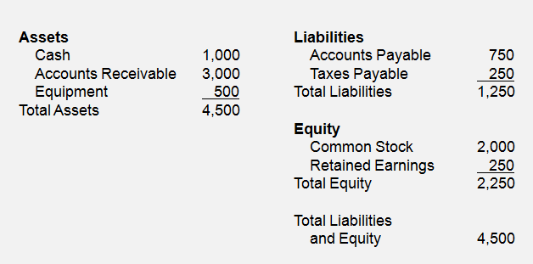
Balance Sheet
Khái niệm về FI
FI Master Data
FI in Logistics
Questions?
Reports
Balance Sheet
Presentation of an organization’s Assets (Tài sản), Liabilities (Nợ), and Equity (Vốn chủ sở hữu) at a point in time
Assets: What the company owns
Liabilities: What the company owes
Equity: The difference between Assets and Liabilities
Assets = Liabilities + Equity

Slide 16
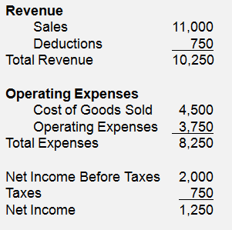
Income Statement
Khái niệm về FI
FI Master Data
FI in Logistics
Questions?
Reports
Income Statement
Presentation of an organization’s revenues and expenses for a given period of time (e.g. monthly, quarterly, or yearly)
Revenues, in a simple sense, are inflows of cash as a result of selling activities or the disposal of company assets.
Expenses, in a simple sense, are outflows of cash or the creation of liabilities to support company operations.
Revenues - Expenses = Net Income

Slide 17
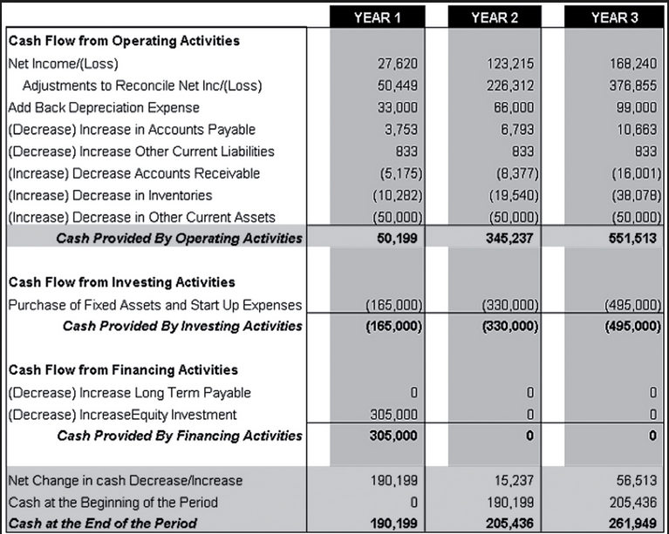
Statement of Cash Flows
Khái niệm về FI
FI Master Data
FI in Logistics
Questions?
Reports
Statement of Cash Flows
Considers the associated changes, both inflows and outflows, that have occurred in cash – arguably the most important of all assets – over a given period of time (e.g. monthly, quarterly, or annually)

Slide 18


FI & MM integration (Purchasing)
Purchase requisition
No impact on
Financial Accounting (FI)
Khái niệm về FI
FI Master Data
FI in Logistics
Questions?
Reports
Purchase order
Materials Management (MM) and Financial Accounting (FI)
via automatic account assignment
Goods receipt
Inventory (1561)
GR / IR (3388)
Dr Cr
Dr Cr
$100
$100

Slide 19
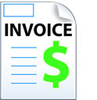
FI & MM integration (Purchasing) cont.
Amount owed is
assigned and transferred to
vendor account payable
Khái niệm về FI
FI Master Data
FI in Logistics
Questions?
Reports
Invoice receipt
GR / IR (3388)
Vendor A/P (331)
Dr Cr
Dr Cr
$100
$100

Slide 20

FI & MM integration (Purchasing) cont.
Amount owed is paid to
vendor and account payable is reduced
Khái niệm về FI
FI Master Data
FI in Logistics
Questions?
Reports
Cash/Bank
Bank – 112
Cash - 111
Vendor A/P (331)
Dr Cr
Dr Cr
$100
$100

Slide 21
FI & MM integration (Purchasing) cont.
Goods Receipt
Invoice Receipt
Payment Program
Khái niệm về FI
FI Master Data
FI in Logistics
Questions?
Reports
AP (Vendor)
Inventory
GR / IR
Bank
Dr Cr
Dr Cr
Dr Cr
Dr Cr
$100
$100
$100
$100
$100
$100

Slide 22
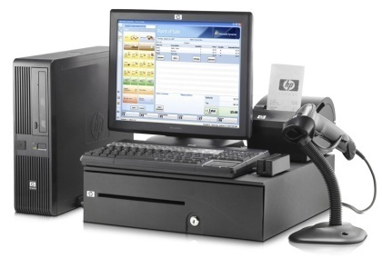
FI & SD integration
Quotation
No impact on
Financial Accounting (FI)
Khái niệm về FI
FI Master Data
FI in Logistics
Questions?
Reports
Sale order
Materials Management (MM) and Financial Accounting (FI)
via automatic account assignment
Goods Issue
COGS (632)
Inventory (1561)
Dr Cr
Dr Cr
$100
$100

Slide 23
FI & SD integration cont.
Amount owner is
assigned and transferred to
Customer account receivable
Khái niệm về FI
FI Master Data
FI in Logistics
Questions?
Reports
Billing
Customer A/R (113)
Revenue (5111)
Dr Cr
Dr Cr
$100
$100

Slide 24
FI & SD integration cont.
Amount debt is paid to
Company and account receivable is reduced
Khái niệm về FI
FI Master Data
FI in Logistics
Questions?
Reports
Cash/Bank
Bank – 112
Cash - 111
Customer A/R (131)
Dr Cr
Dr Cr
$100
$100

Slide 25
Double entry FI with SD & MM & Tax
Bán hàng |  |  | Mua hàng
Xuất kho | Debit | Credit | Nhận hàng | Debit | Credit
 | 632 (Giá vốn hàng bán) | 1561 (Hàng hóa) |  | 1561 (Hàng hóa) | 3388 (TK trung gian)
Xuất hóa đơn | Debit | Credit | Nhận hóa đơn đầu vào | Debit | Credit
 | 131 (Khoản phải thu) | 5111 (Doanh thu) 3331 (VAT đầu ra) |  | 3388 (TK trung gian) 1331 (VAT vào) | 331 (Phải trả)
Thanh toán | Debit | Credit | Thanh toán | Debit | Credit
 | 112 hoặc 111 (Tiền gửi NH hoặc Tiền mặt) | 131 (khoản phải thu) |  | 331 (Phải trả) | 112 hoặc 111 (Tiền gửi NH hoặc Tiền mặt)

Slide 26
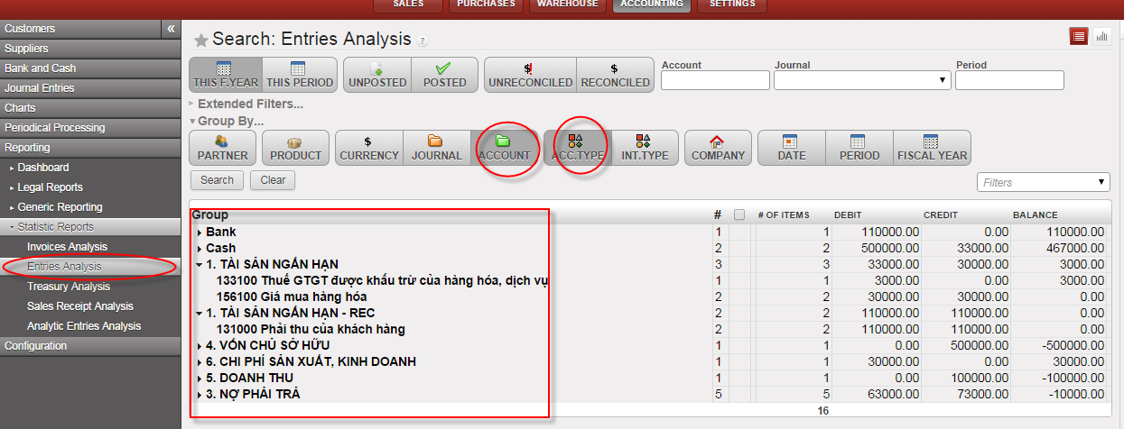
Check all Entries

Slide 27
Câu hỏi?

